Slide 1

Hotel Plaza
Jakub Patelski
Wanessa Wintmiller
Monika Ozdoba
Anders Jensen

Slide 2
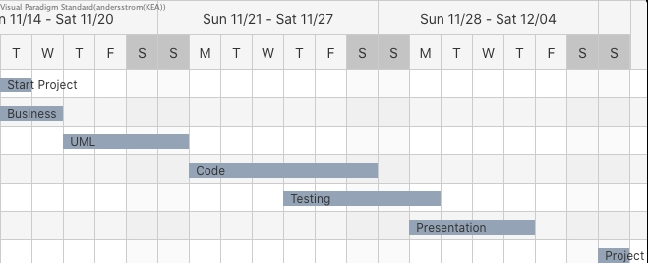
Gantt Chart

Slide 3
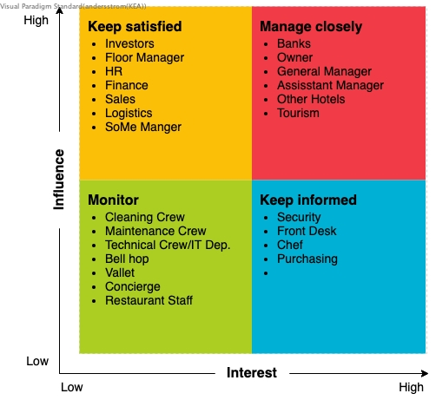
Steakholder Analysis

Slide 4
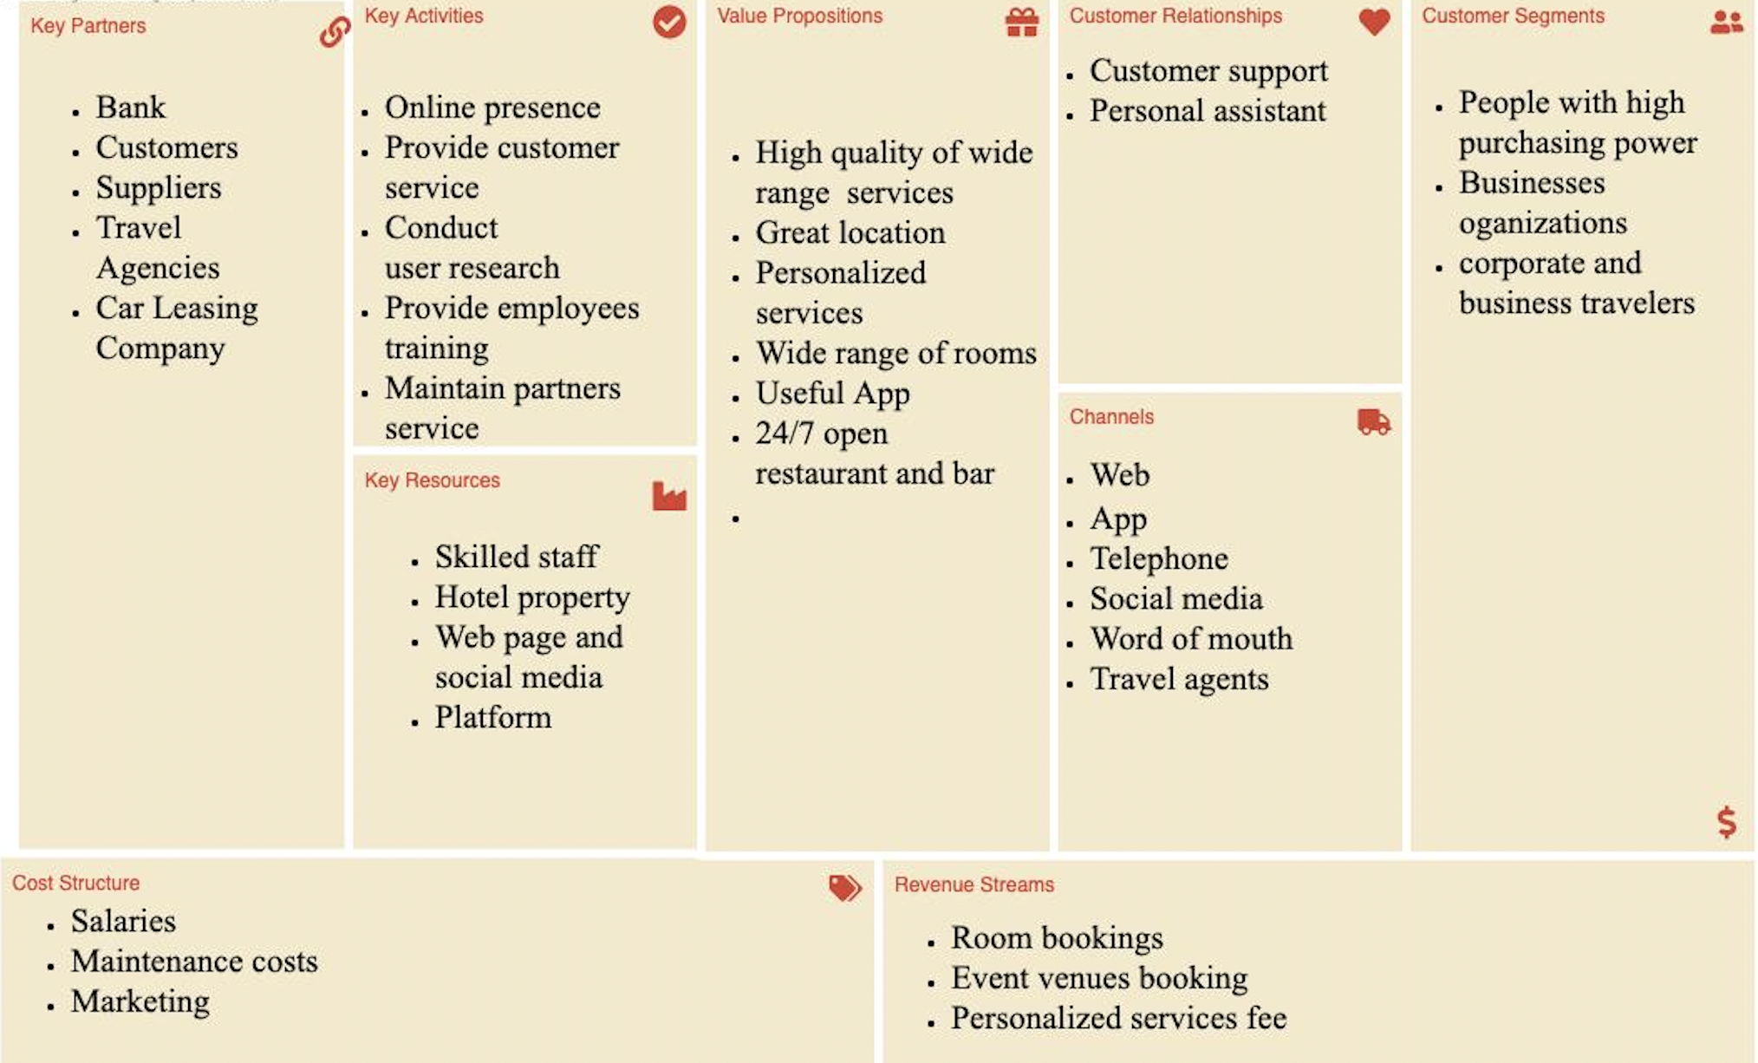
Business Model Canvas

Slide 5
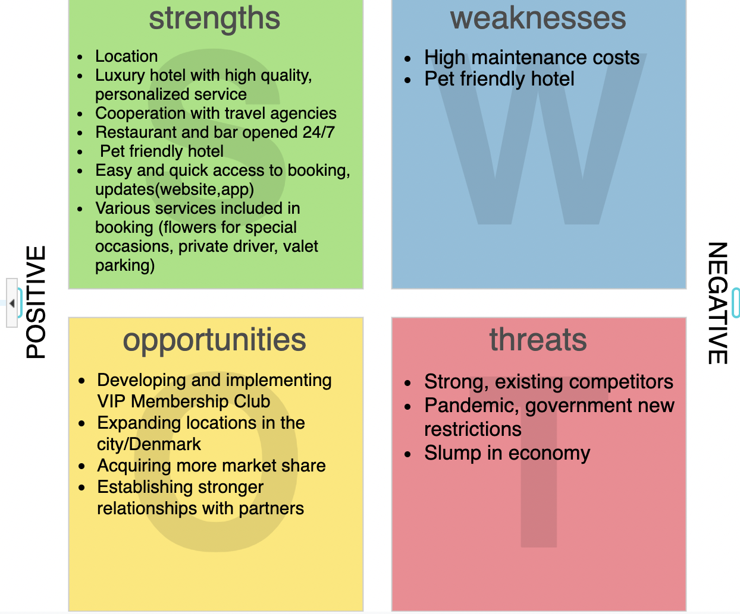
Swot Anaalysis

Slide 6
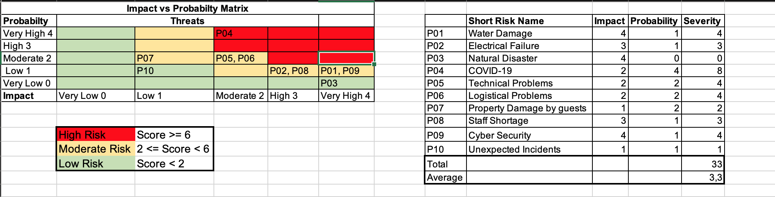
Risk Analysis

Slide 7
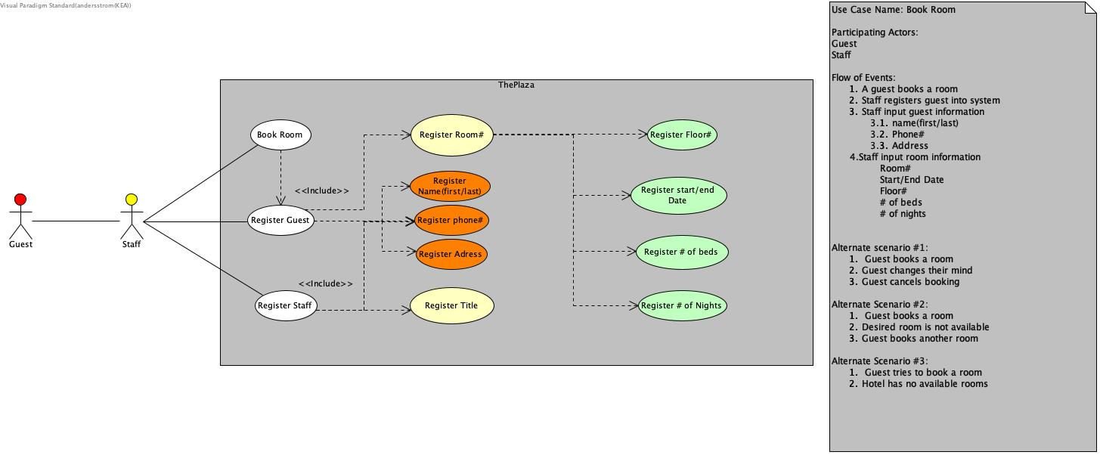
Use Case

Slide 8
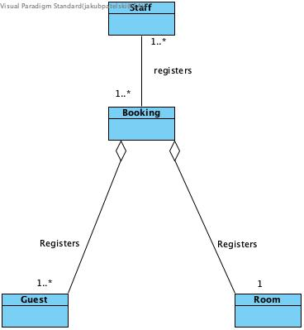
Domain Model

Slide 9
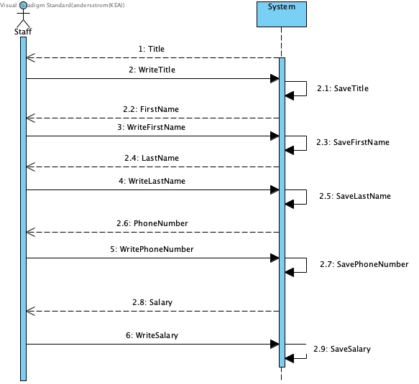
System Sequence Diagram register staff

Slide 10
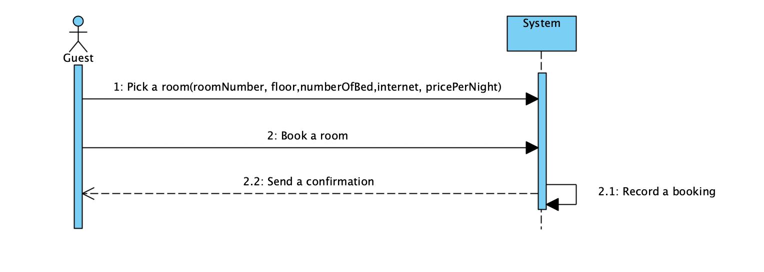
System sequence diagram Book A Room

Slide 11
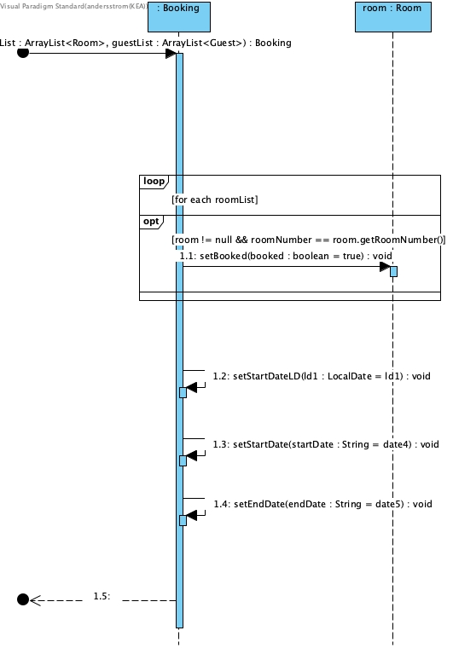
Sequence Diagram Book A Room

Slide 12
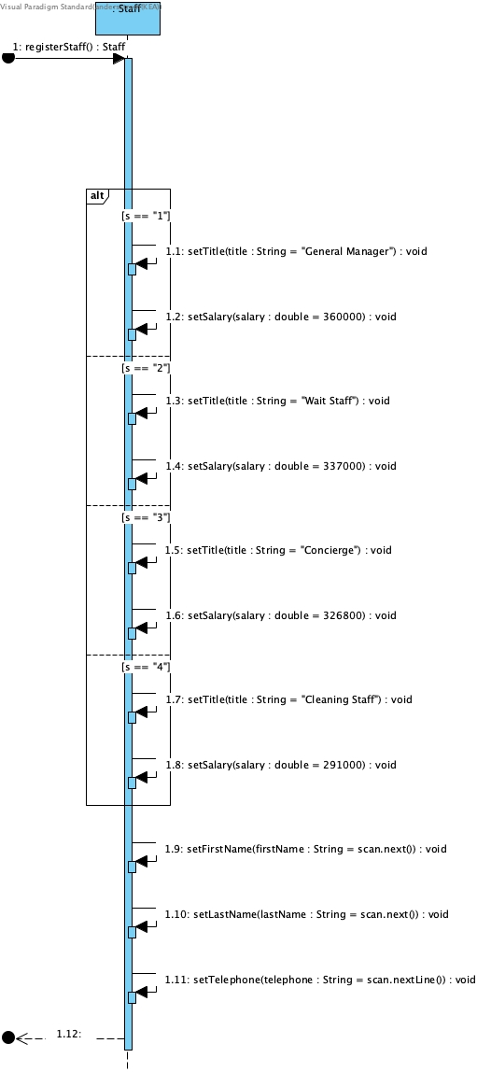
Sequence Diagram Register Staff

Slide 13
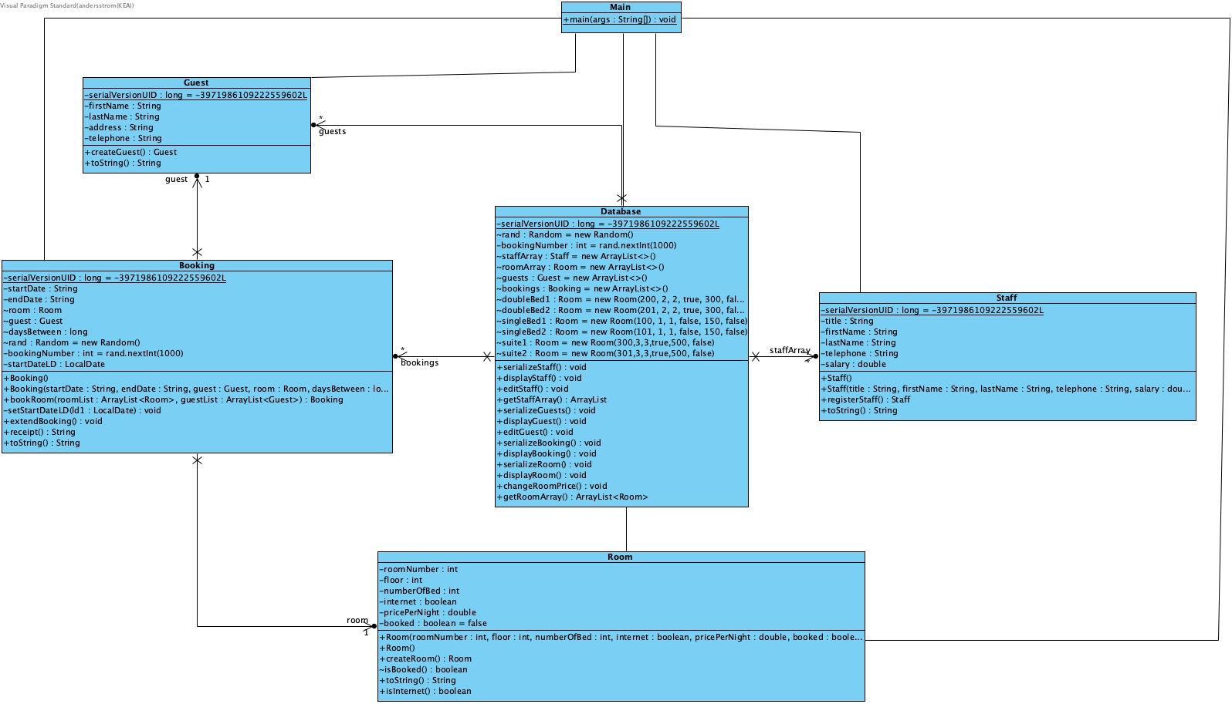
Class Diagram

